Slide 1
Interpolating
Polynomial –
Lagrange Method
Group 15
Berces, Arthur William
Damasco, Vinard James
Espiritu, Kyle Gabrielle

Slide 2
Definition
The Lagrange interpolation formula is a way to find a polynomial coefficient which takes on certain values at arbitrary points.

Slide 3
Purpose
The Lagrange form of the interpolation polynomial shows the linear character of polynomial interpolation and the uniqueness of the interpolation polynomial. Therefore, it is preferred in proofs and theoretical arguments.

Slide 4
What is the program all about?
The program is a calculator that uses Lagrange for polynomial interpolation. It allows the entering of an x value and sets of points. The program will find new data points within a range of a discrete set of known data points.

Slide 5
What is the program all about?
For the data set portion of the program, we used the EOS cryptocurrency’s exchange rate to USD found on:
https://www.coingecko.com/en/coins/eos

Slide 6
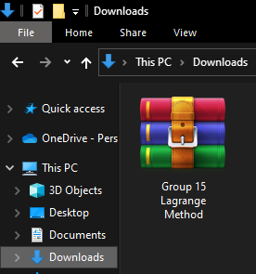
How to execute the program?
Download the archived .rar file we have uploaded in Blackboard and save it in your Downloads directory

Slide 7
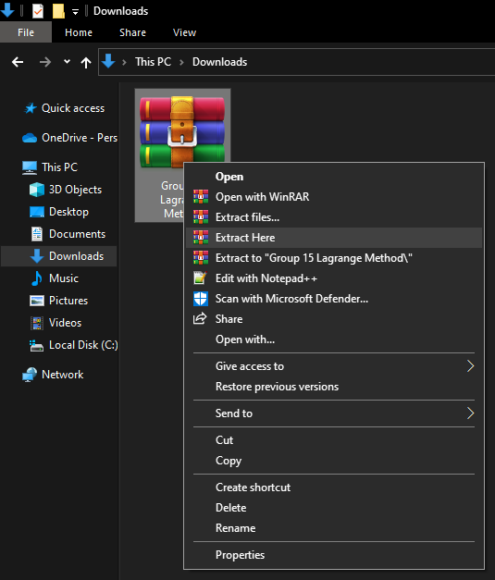
How to execute the program?
Once downloaded, extract its contents in the same directory

Slide 8
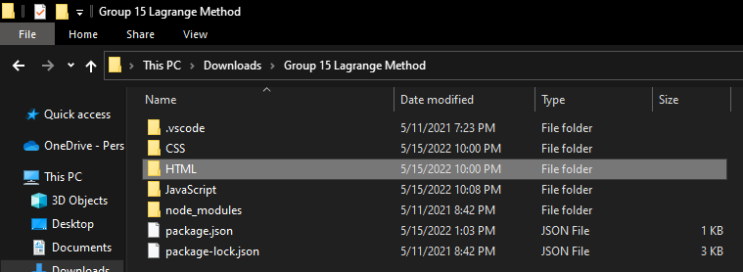
How to execute the program?
Once extracted, open the folder named “HTLM”

Slide 9
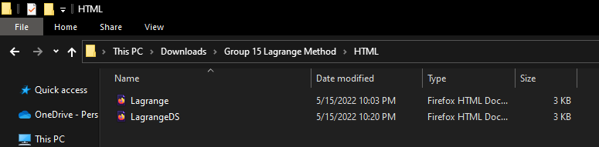
How to execute the program?
Once inside the folder named “HTML”, double-click or right-click and open the file named “Lagrange” or “LagrangeDS”

Slide 10
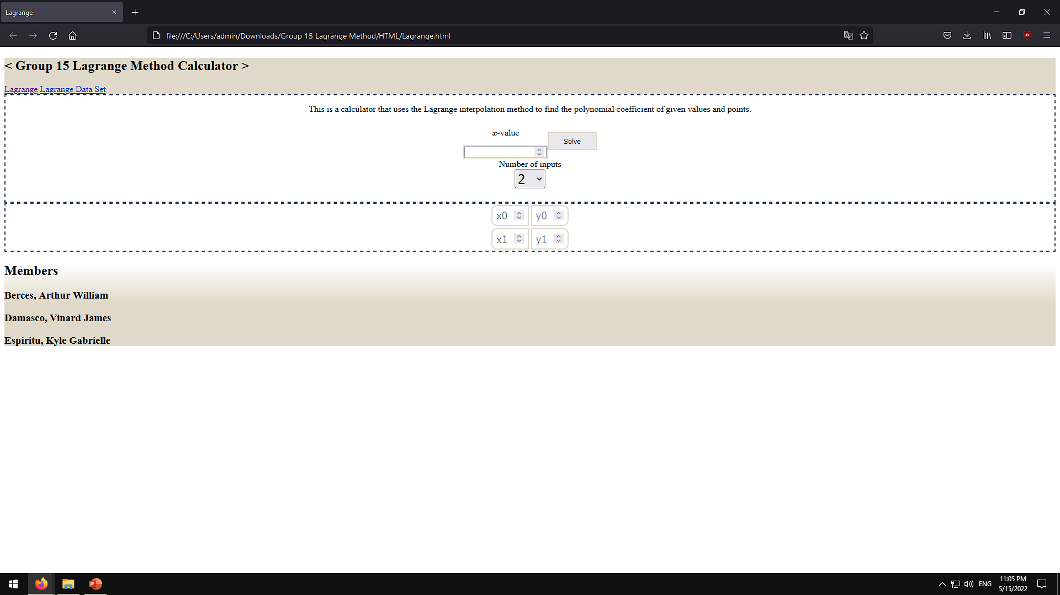
How to execute the program?
You can now use our program

Slide 11
Thank You

